Slide 1
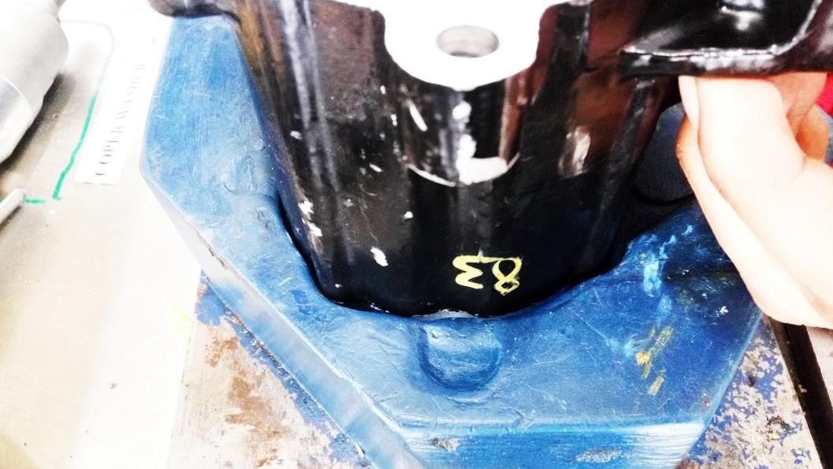
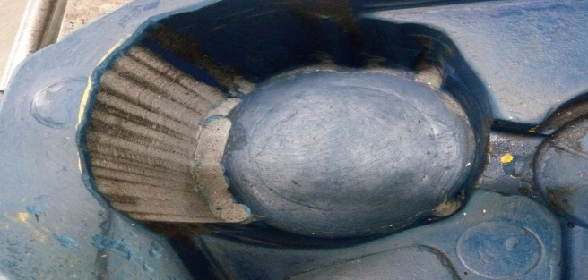
P15
TPM CIRCLE NO :- 01
ACTIVITY
KK
QM
PM
JH
SHE
OT
DM
E&T
KAIZEN IDEA SHEET
TPM CIRCLE NAME:
LOSS NO. / STEP
DEPT :- ASSEMBLY
RESULT AREA
P
Q
A
C
D
S
M
CELL:- oil pump
CELL NAME:- A293
MACHINE / STAGE :- Assembly
OPERATION :- Assembly
KAIZEN THEME : To avoid the rejection of face damage during assembly.
IDEA :- Fixture cutting required to avoid direct contact between body & fixture.
Problem present status :- Pump found leak at customer end due to dia.78.3 damage.
COUNTERMEASURE:-
1) Clearance will be increase so there will be no direct contact between dia.78.3 & fixture resting edge during the assembly of pump
BENCHMARK
TARGET
KAIZEN START
18.05.2016
TDC
15.09.2016
TEAM MEMBERS : Amit Dhage ,Sachin
Kadnar, Nitin sutar
KAIZEN FINISH
15.09.2016
BENEFITS :-
1) To eliminate the customer complaint of leak fail.
Before
After
KAIZEN SUSTENANCE
WHY - WHY ANALYSIS :-
Why1 :- Pump found leak at customer end due to dia.78.3 damage.
Why2 :- Projecting edge generates on final assembly stage
Why3 :- Part Foul on Fixture
Why4:- Very less clearance between dia.78.3 & resting fixture which causes sudden damage.
RESULT :-
WHAT TO DO:- After implementation point added in JH check sheet.
HOW TO DO:- At the start of shift
FREQUENCY :- Start of shift
Results under monitoring
ROOT CAUSE : Very less clearance between dia.78.3 & resting fixture which causes sudden damage.
REGISTRATION NO. & DATE :- 18.05.2016
SCOPE & PLAN FOR HORIZONTAL DEPLOYMENT
REGISTERED BY :- Amit Dhage
SR.
NO.
CELL
TARGET
RESPONSIBILITY
STATUS
MANAGER’S SIGN :- Sandeep Patil
1
NA
NA
NA
NA

